Slide 1
Compiler design, 14CS73 SLR, CLR/LR(1), LALR
By Dr. Saroja Devi H.

Slide 2
SLR Parser
The SLR parser is similar to LR(0) parser except that the reduced entry. The reduced productions are written only in the FOLLOW of the variable whose production is reduced, and conflict is avoided.
Every SLR(1) grammar is unambiguous but there are many unambiguous grammars that are not SLR(1).
If in the parsing table we have multiple entries then it is said to be a conflict and then it is not SLR.
The SLR method begins with LR(0) items and LR(0) automata. ACTION and GOTO entries are determined using the SLR parsing table construction algorithm.

Slide 3
Construction of SLR table
Input: augmented grammar G’ ; Output: SLR parsing table with ACTION and GOTO for G’
1. Construct C = { I₀, I₁, ……. I_{n}}, the collection of sets of LR(0) items for G’.
2. State i is constructed from Ii. The parsing actions for state i are determined as follows :
If [ A -> α.aβ] is in I_{i} and GOTO(I_{i} , a) = I_{j} , then set ACTION[i, a] to “shift j”. Here a must be terminal.
If [A -> α.] is in I_{i}, then set ACTION[i, a] to “reduce A -> α ” for all a in FOLLOW(A); here A may not be S’.
Is [S -> S.] is in I_{i}, then set action[i, $] to “accept”.
If any conflicting actions are generated by the above rules we say that the grammar is not SLR(1). The algorithm fails to produce a parser then.
3. The goto transitions for state i are constructed for all nonterminals A using the rule: if GOTO( I_{i} , A ) = I_{j} then GOTO [i, A] = j.
4. All entries not defined by rules 2 and 3 are made error.
5. The initial state of the parser is the one constructed from the set of items
containing [S' ->• S].

Slide 4
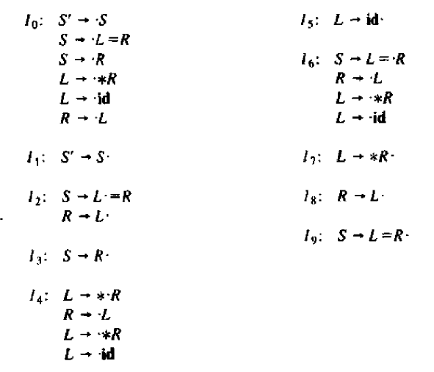
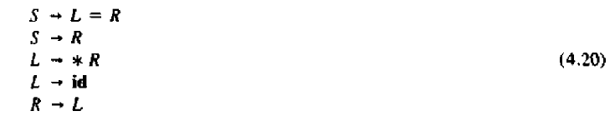
SLR(1) grammar and ambiguity Every SLR(1) is unambiguous, but there are many unambiguous grammars that are not SLR(l)
grammar
4.20
Shift reduce conflict
Canonical LR(0) collection for grammar 4.20 =>
State 2 has shift to 6 action and also reduce by R->L. Both for symbol = , as = symbol is in follow set of R.

Slide 5
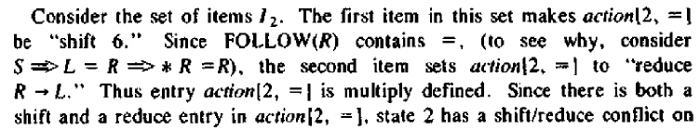
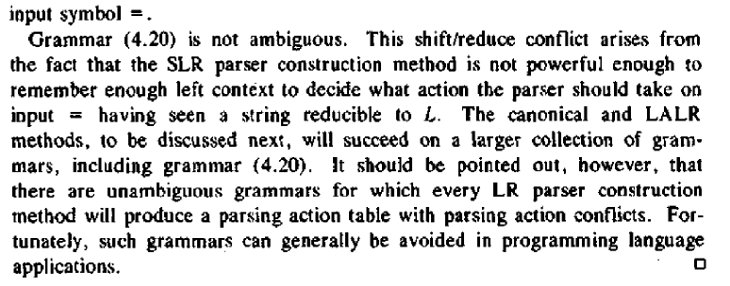
Analysis of SLR(1) (contd…)

Slide 6
More powerful LR parsers
The LR parsing technique is extended to use one symbol of lookahead on the input. Purpose is to detect better/more grammars. Two methods:
The canonical LR which makes use of lookahead symbols. This makes larger set of items, termed LR(1) items.
The lookahead LR or LALR method which is based on LR(0) set of items. It has fewer states than the typical parsers based on the LR(1) items. By carefully introducing lookaheads into the LR(0) items, we get LALR with which we can manage many more grammars. We can have smaller or same table size. YACC tool uses LALR method.

Slide 7
CLR Parser (Canonical LR)
In the SLR method we were working with LR(0)) items. In CLR parsing we will be using LR(1) items. LR(k) item is defined to be an item using lookaheads of length k.
So , the LR(1) item is comprised of two parts : the LR(0) item and the lookahead associated with the item. LR(1) parsers are more powerful parser. For LR(1) items we modify the Closure and GOTO function.

Slide 8
Constructing LR(1) Sets of Items: Closure operation for CLR/LR(1)
SetOfItems CLOSURE(I) {
repeat
for (each item [ A -> α.Bβ, a ] in I )
for (each production B ->γ in G’)
for (each terminal b in FIRST(β a))
add [ B ->. γ, b ] to set I;
until no more items are added to I;
return I;
}

Slide 9
LR(1): GOTO, and set of items collection
SetOfltems GOTO(I, X) {
initialize J to be the empty set;
for ( each item [A -> α.Xβ, a] in I )
add item [A -> αX.β, a] to set J;
return CLOSURE(J);
}
void items(G') { /* grammar G’ ; C : collection */
initialize C to CLOSURE({[S' ->•S, $]});
repeat
for ( each set of items I in C )
for ( each grammar symbol X )
if ( GOTO(I,X) is not empty and not in C )
add GOTO(I, X) to C;
until no new sets of items are added to C;
}

Slide 10
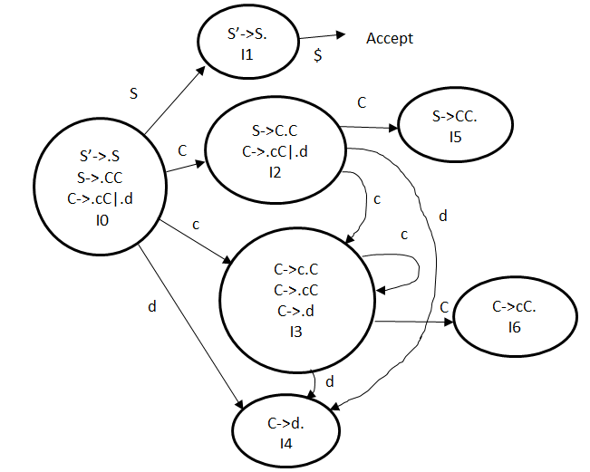
LR(0)/SLR parsing
Grammar:
S’-> S
S-> CC
C-> cC | d
Total 7 states

Slide 11
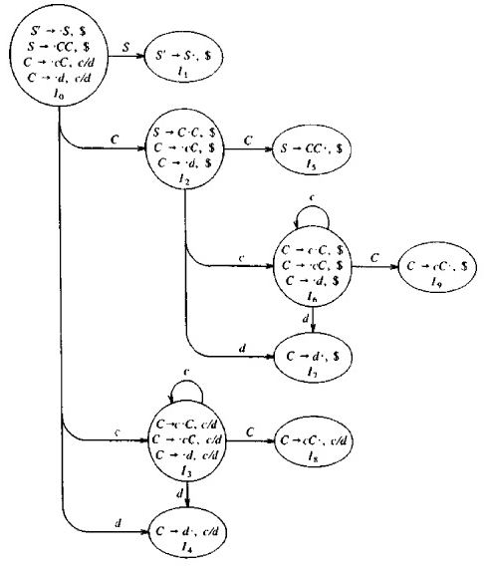
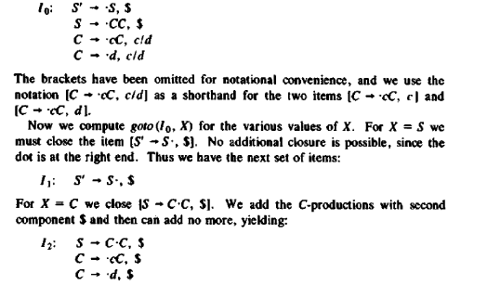
Example for LR(1)
$
Accept
Grammar:
S’-> S
S-> CC
C-> cC | d
Total 10 states
Stars indicate
merging option

Slide 12
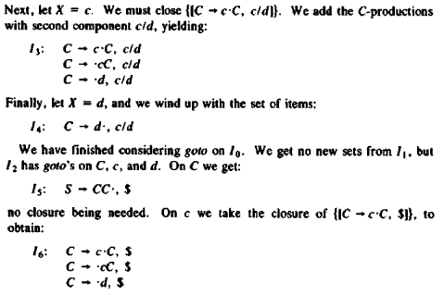
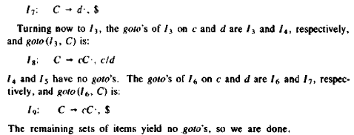
LR(1) Example(contd..)
Grammar: S’-> S
1.S-> CC
2.C-> cC
3.C-> d

Slide 13
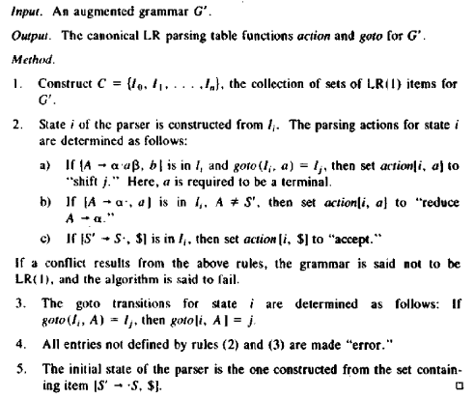
CLR parsing table : Algorithm

Slide 14
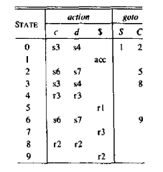
Canonical LR(1) Parsing table
Grammar:
1.S-> CC
2.C-> cC
3.C-> d
Every SLR(1) grammar is an LR(1) grammar
For an SLR(1) grammar the canonical LR parser may have more states (10 states) than SLR parser for the same grammar
(7 states).

Slide 15
LALR (Look Ahead LR) Parser
LALR parser are same as CLR parser with one difference. In CLR parser if two states differ only in lookahead then we combine those states in LALR parser. After minimisation if the parsing table has no conflict, then that the grammar is LALR also.
Even though CLR parser does not have RR conflict but LALR may contain RR conflict.
If there are no parsing table conflicts, then the given grammar is said to be an LALR(1) grammar and the collection of items is LALR(1) collection.
If number of states LR(0) = n1, number of states SLR = n2, number of states LALR = n3, number of states CLR = n4 then, n1 = n2 = n3 <= n4

Slide 16
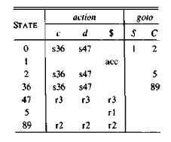
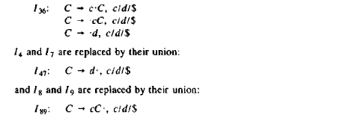
LALR Example & table construction
Grammar: S’-> S
1.S-> CC
2.C-> cC
3.C-> d
3pairs of sets of items can be merged: 3&6; 4&7 ; 8&9, forming, say union set I36 because Items are same, lookahead chr. is different.
The GOTOs are also merged. Ex. GOTO(I3, C) = I8, and I8 is part of I89, so GOTO(I36, C) is I89.

Slide 17
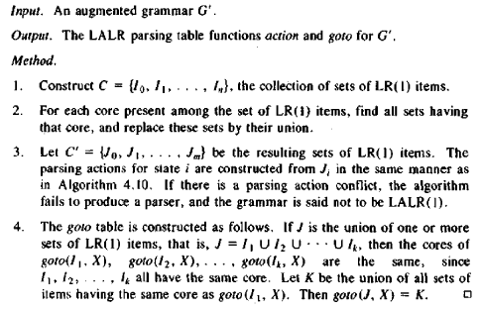
Algorithm for LALR table construction

Slide 18
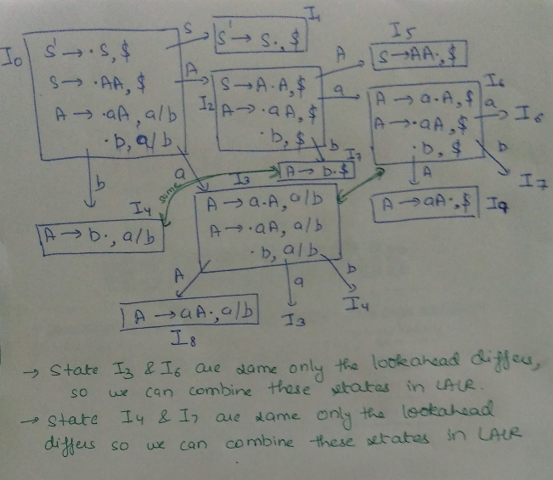
LR(1)/LALR Example : try
consider the grammar:
S ->AA
A -> aA | b
Augmented grammar:
S’ -> S
S ->AA
A -> aA | b

Slide 19
Efficient construction of LALR parsing table
Purpose is to avoid constructing the full collection of sets of LR(1) items for LALR(1) parsing table.
• First, we can represent any set of LR(0) or LR(1) items I by its kernel,
that is, by those items that are either the initial item [S' -> •S] or
[S' ->• S, $] or that have the dot somewhere other than at the beginning
of the production body.
• We can construct the LALR(1) item kernels from the LR(0) item kernels
by a process of propagation and spontaneous generation of lookaheads.
• If we have the LALR(1) kernels, we can generate the LALR(1) parsing
table by closing each kernel, using the function CLOSURE, and
then computing table entries by CLR Algorithm, as if the LALR(1) sets
of items were canonical LR(1) sets of items.
[Refer to example 4.61 from the text book, do the propagation of lookaheads (#) and computation of lookaheads (=) ]

Slide 20
Using Ambiguous grammar & Error recovery
Using precedence and associativity to resolve parsing action conflicts
Ambiguous grammar: E->E + E| E*E | (E) I id , because it does not specify the associativity or precedence of operators + and *. This shows up in the parsing table with shift or reduce on * & + , not indicating which one to do first, for input say, id+id*id, tending to reduce first.
The unambiguous grammar, E-> E+T | T ; T-> T*F|F; F->(E) |id gives + lower precedence than * and makes both left associative.
Dangling else problem: S->iSeS|iS|a => shift/reduce conflict. S->iS.eS requires shift of e.
But FOLLOW(S)={e,$}, so item S->iS. indicates reduction by S->iS on input e.
Error recovery: detected in action table not in goto table.
Panic mode error recovery: scan down the stack & discard symbols until a valid state is found.
Phrase level error recovery : examining each error entry in the LR parsing table and deciding on the basis of language usage the most likely programmer error that would give rise to that error. An appropriate recovery procedure can then be constructed for specific error entry in the table

